Slide 1


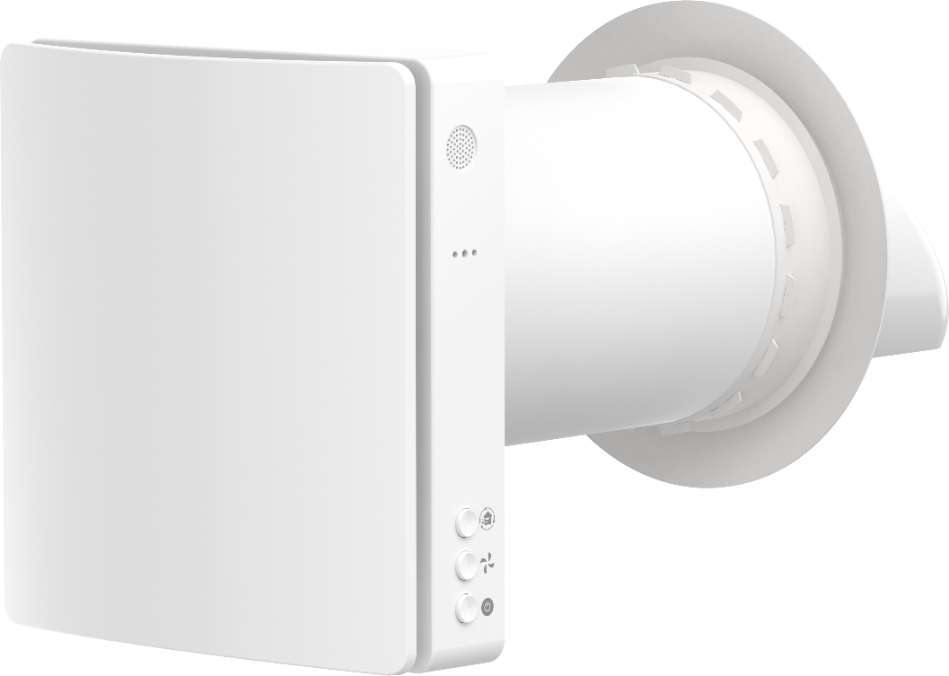


ECO Pair PLUS
Single Room Energy Recovery Ventilator
Beijing Holtop Air Conditioning Co., Ltd
HOLTOP & AIRWOODS brand
Breathe easy live sustainably with Eco-Pair Plus

Slide 2
Vent-US Import Data in 2023 2024
Month/Year | Jan-23 | Feb-23 | Apr-23 | May-23 | Jun-23 | Jul-23 | Sep-23 | Oct-23 | Nov-23 | Sum
Quantity | 652 | 320 | 2011 | 665 | 1495 | 1016 | 909 | 676 | 1692 | 9436
Month/Year | Jan-24 | Feb-24 | Mar-24 | Apr-24 | May-24 | Jun-24 | Jul-24 | Aug-24 | Sep-24 | Sum
Quantity | 1110 | 908 | 1358 | 1330 | 5127 | 5269 | 444 | 1570 | 1670 | 18786

Slide 3

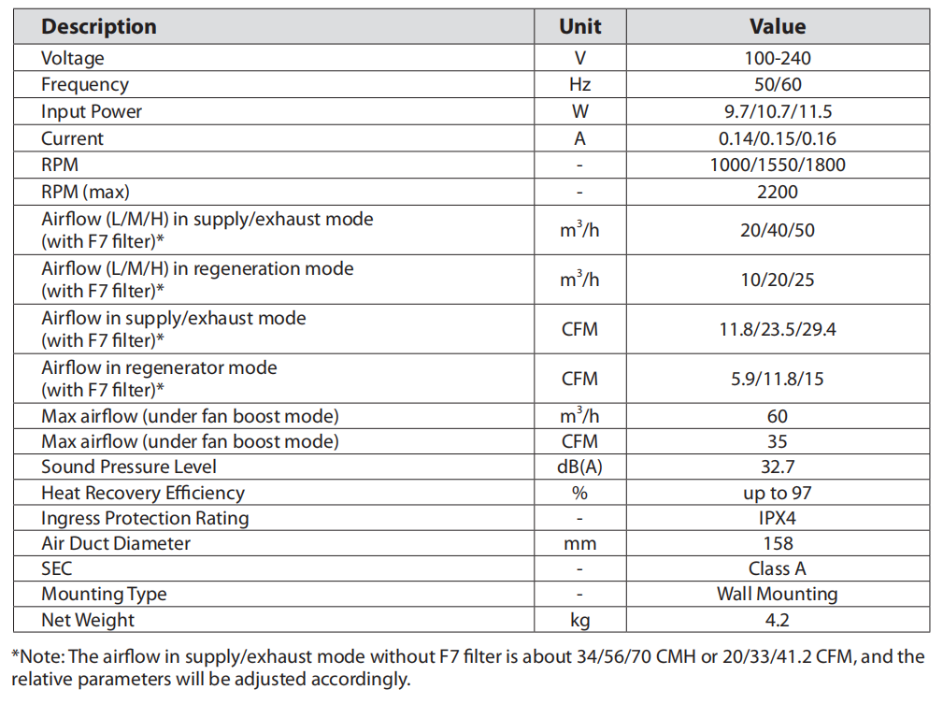
Technical Parameters
IPX4

Slide 4

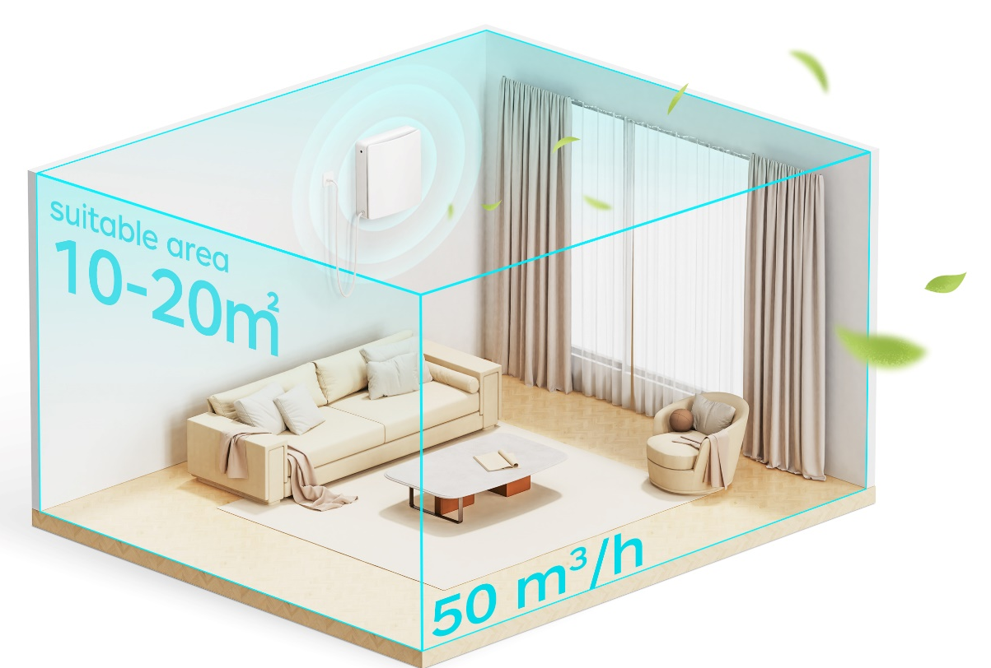
Space application
Standard: 30cfm, customized up to 47cfm

Slide 5
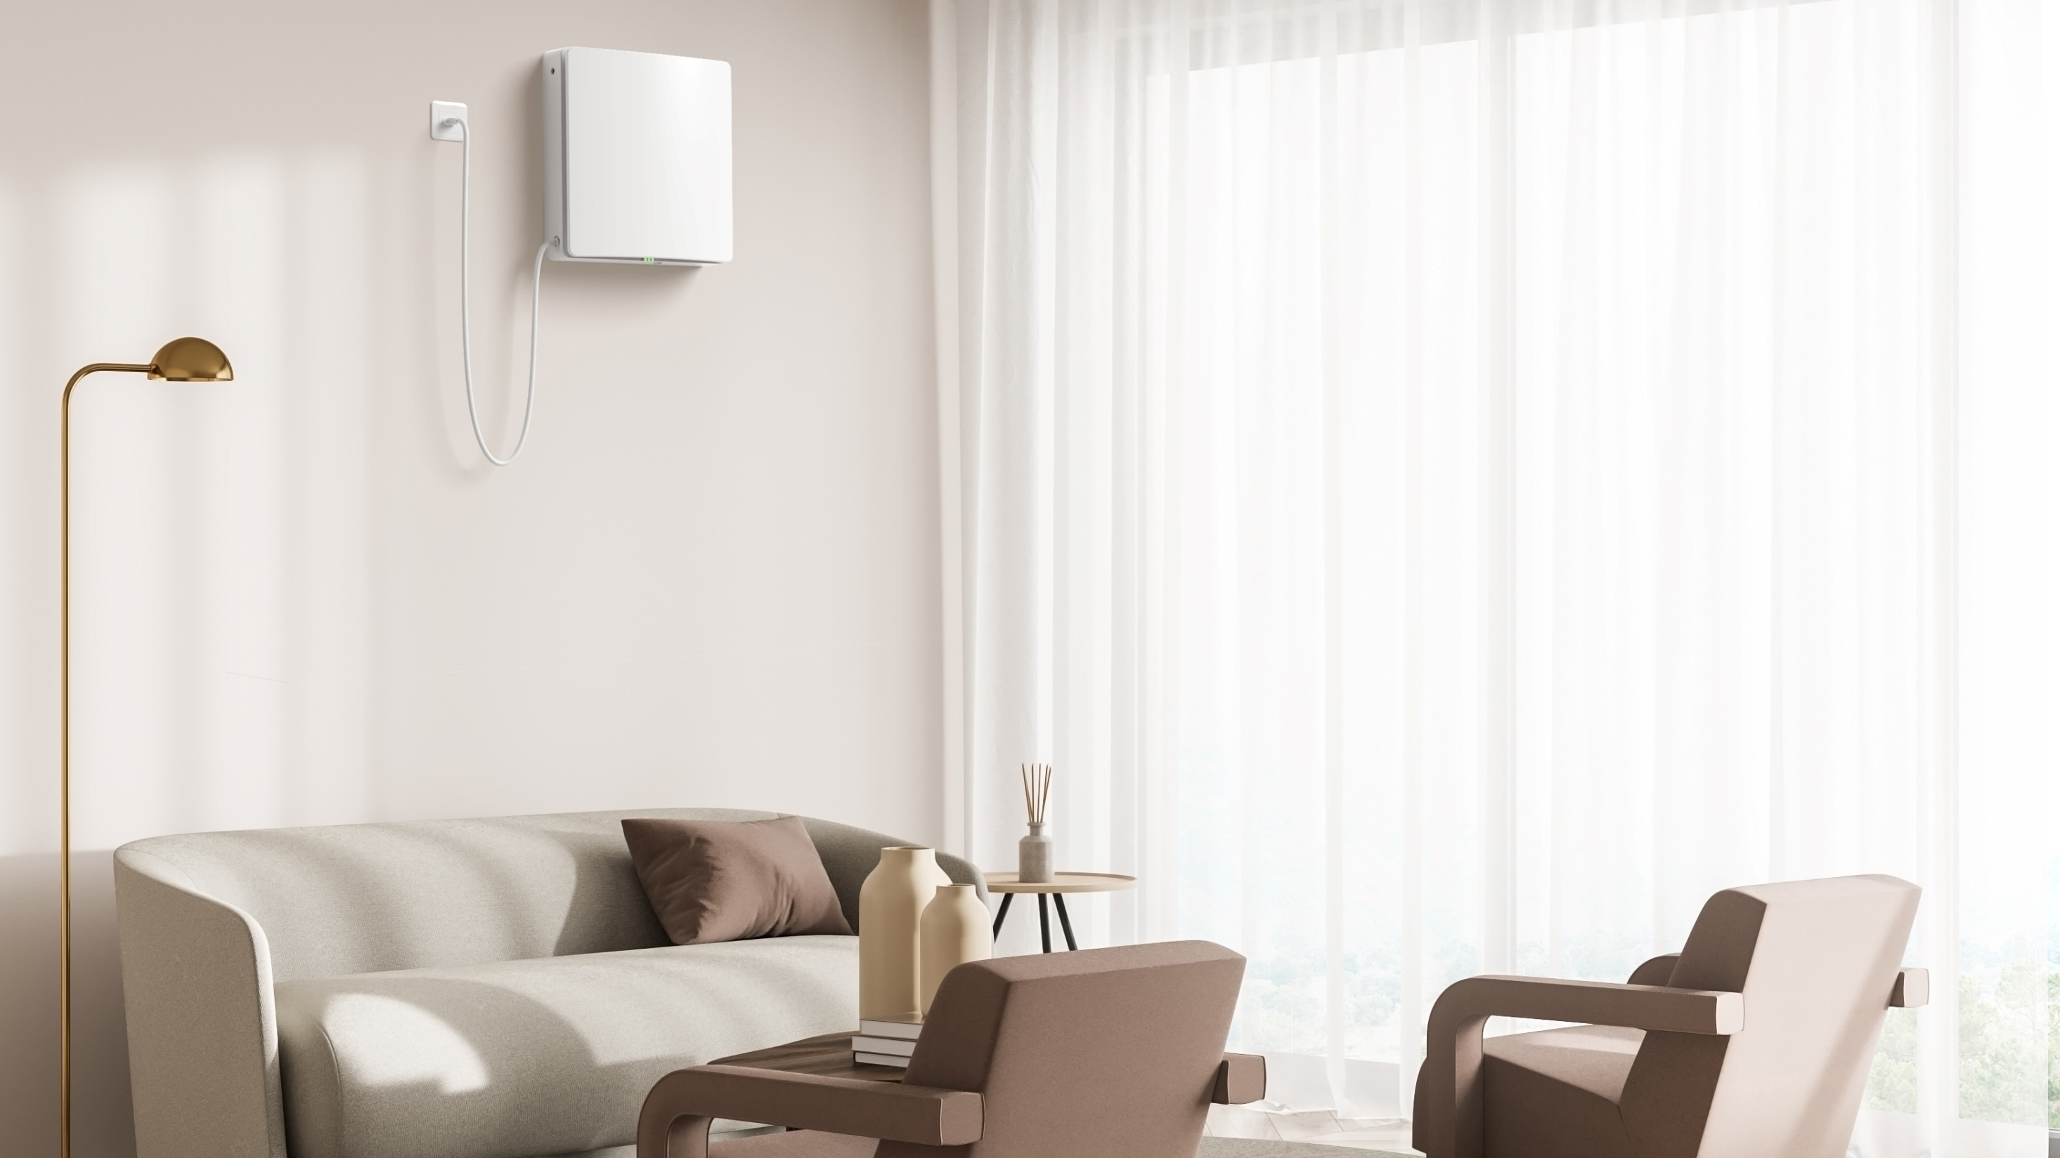











Elegant and DIY decorative front panel.
Automatic shutter to prevent back draught
Key features
One-stop installation indoor witha single hole.
High thermal efficiency up to 97%.
Free-cooling
Reversible 3 speed EC fan, 7.8W.
Easy control by button, remote controller
Flexible operation, working individually or in pairs
APP control/group control
Quiet operation of less than 32.7dB[A)
Smart IAQ control/CO2/humidity/TVOC

Slide 6

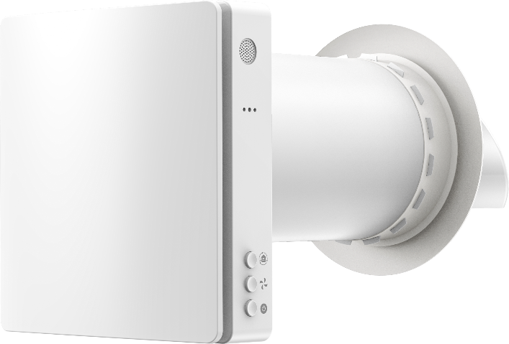
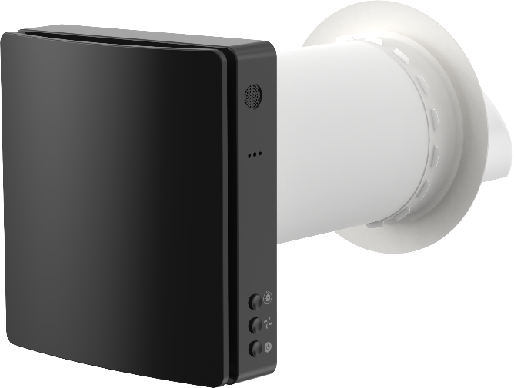

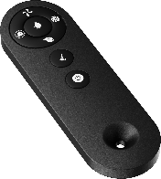
Elegant Decorative
Front Panel
Black or white?
Or fabric?
As you wish
No impact on the existing decoration

Slide 7
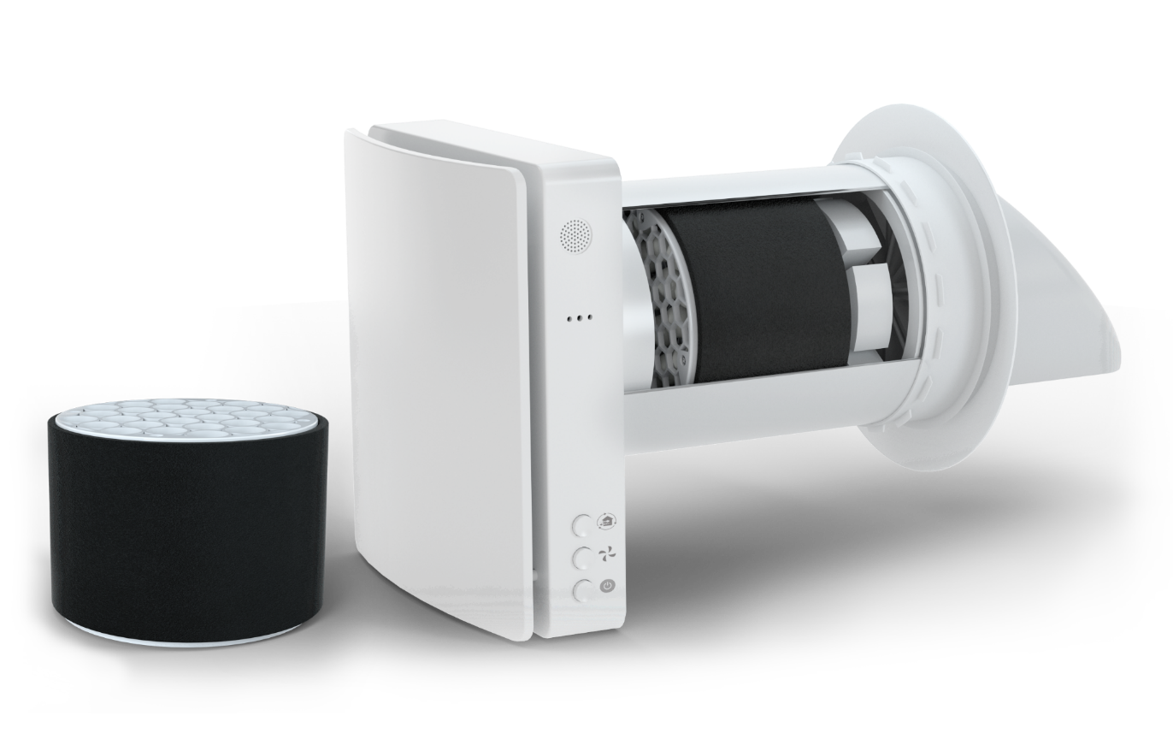
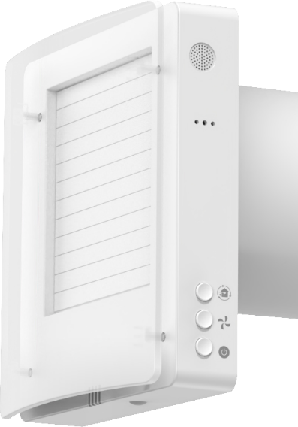
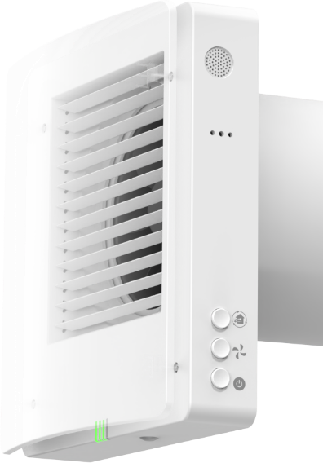
Ceramic Energy Regenerator
Auto shutter
Up to 97% thermal efficiency
To prevents air back draught
OFF ON

Slide 8

Reversible DC Motor
Reversible axial EC - low power consumption and silent operation
With thermal protection and ball bearings - longer lifetime
20 dBA ~ 32.7 dBA
Low noise to ensure sleeping quality

Slide 9
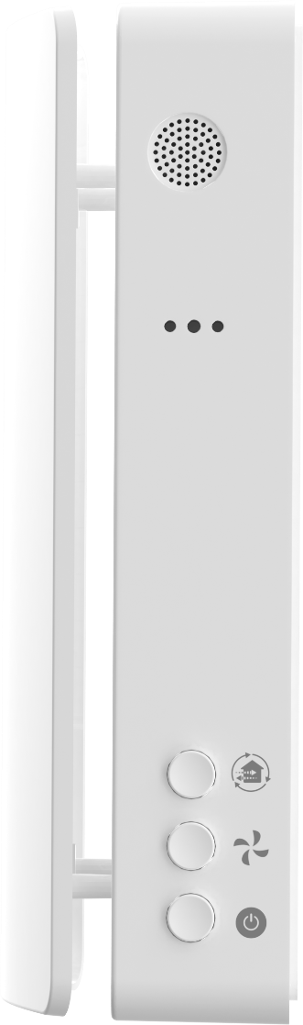
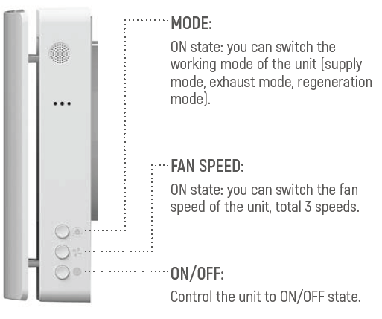
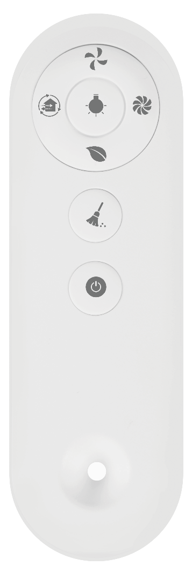
Easy Control
MODE:
supplymode,
exhaust mode regenerationmode
Fan Speed
Indicator Light ON/OFF
Fan Boost
Negative Ion ON/OFF
Filter reset
FAN SPEED: 3 speeds
ON/OFF
Working mode
ON/OFF

Slide 10

App Control

Slide 11

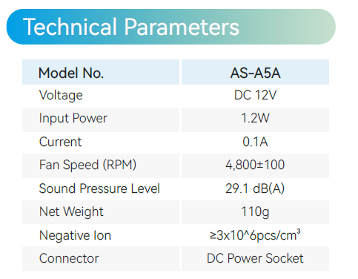


IAQ Control
Negative Ions Generator

Slide 12






IAQ Control
FREE COOLING
Equipped with a temperature sensor as standard. When the outdoor air is comfortable, it will work in supply mode to introduce fresh air without heat recovery, it’s called free cooling. When the unit detects the outdoor temperature is within ±1°C of the set temperature, it will automatically switch to supply mode to supply more fresh air.
CO2 CONTROL (Optional Humidity Control)
Eco-pair plus is equipped with a CO2 sensor (optional with humidity sensor) as standard, when the ERV works in regeneration mode, if the indoor CO2 exceeds the set CO2 values, the ERV will automatically switch to supply mode until the CO2 value is lower than the set value.

Slide 13
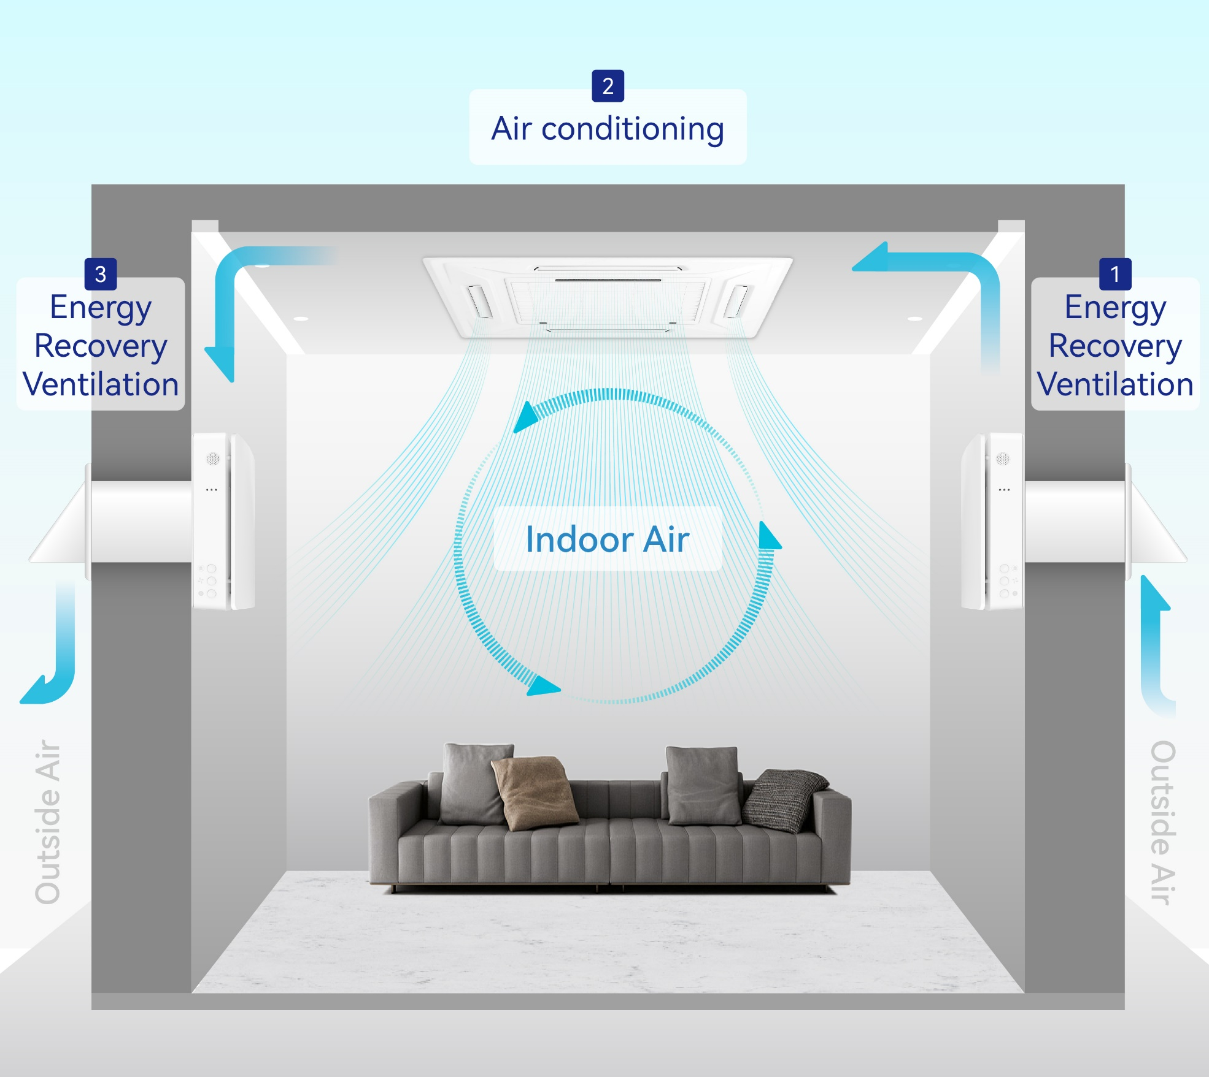
Wireless Pair Control
Balanced Ventilation
Master supplies air runs 75s
the slave extracts indoor stale air for 75s simutaniously

Slide 14
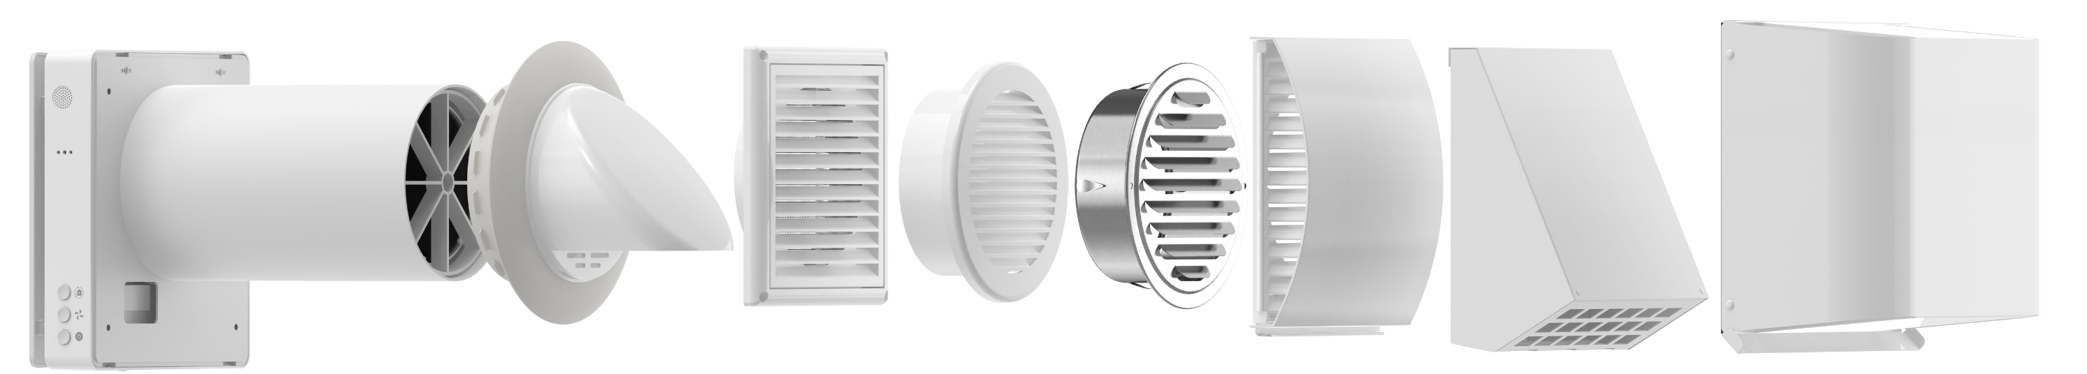
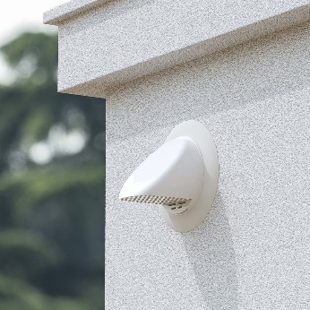
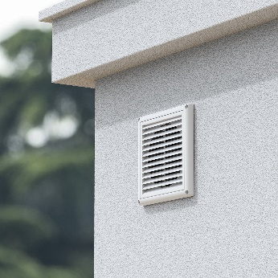
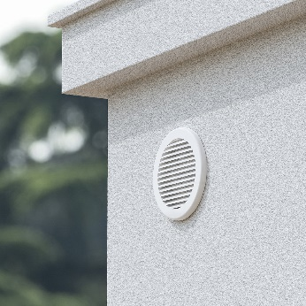
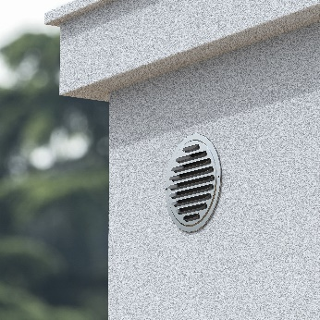
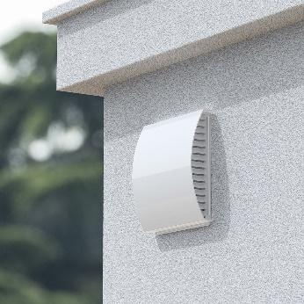
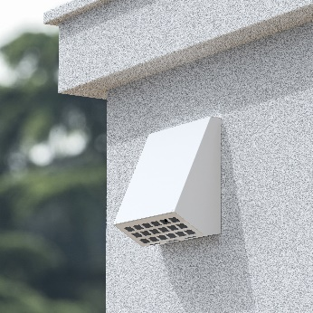
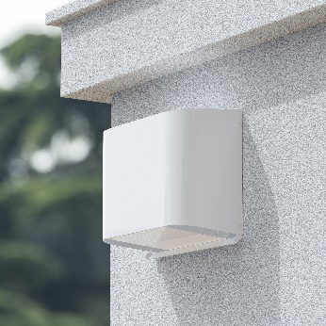
Various outer hood optional

Slide 15
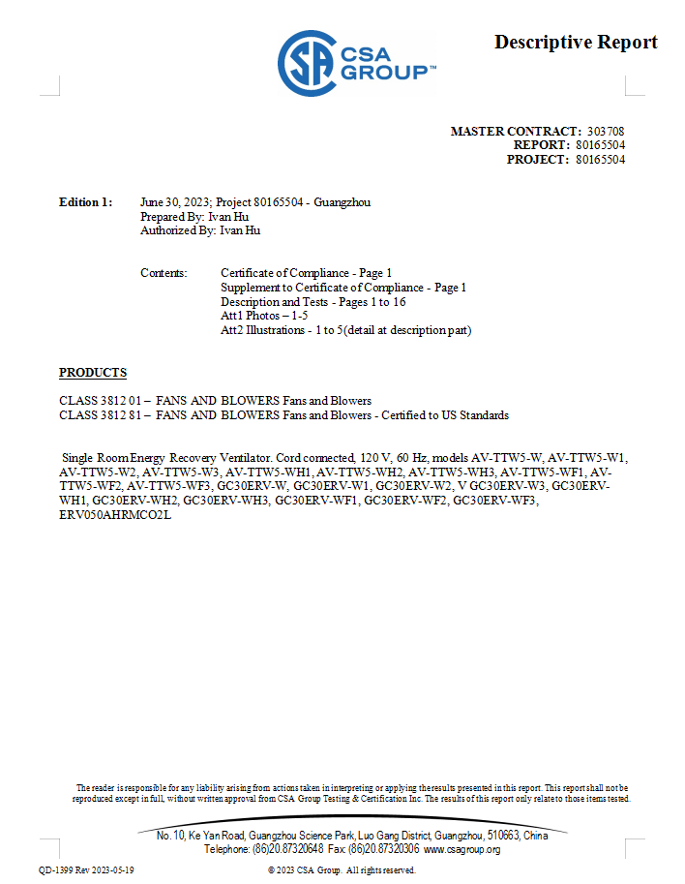
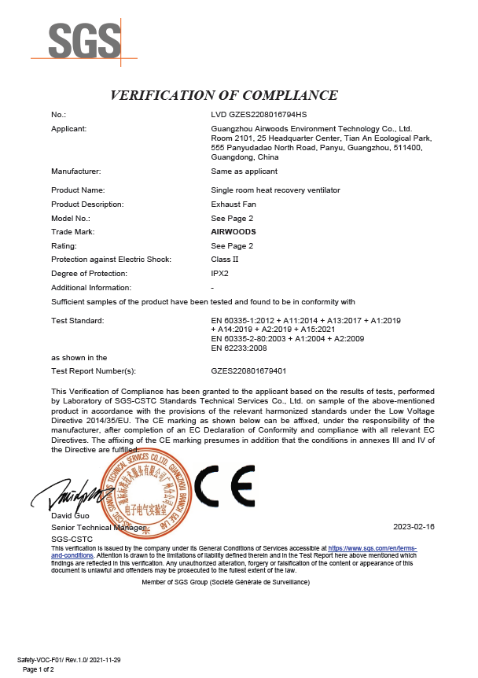
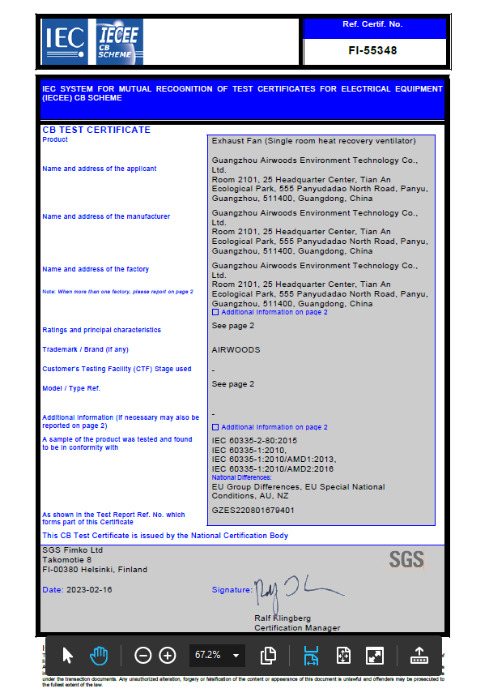
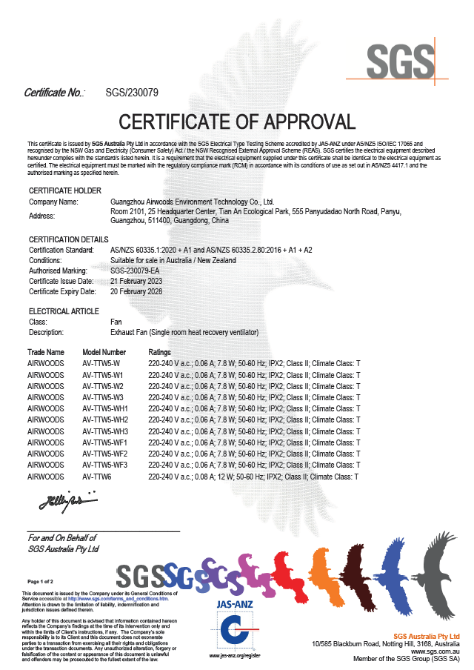
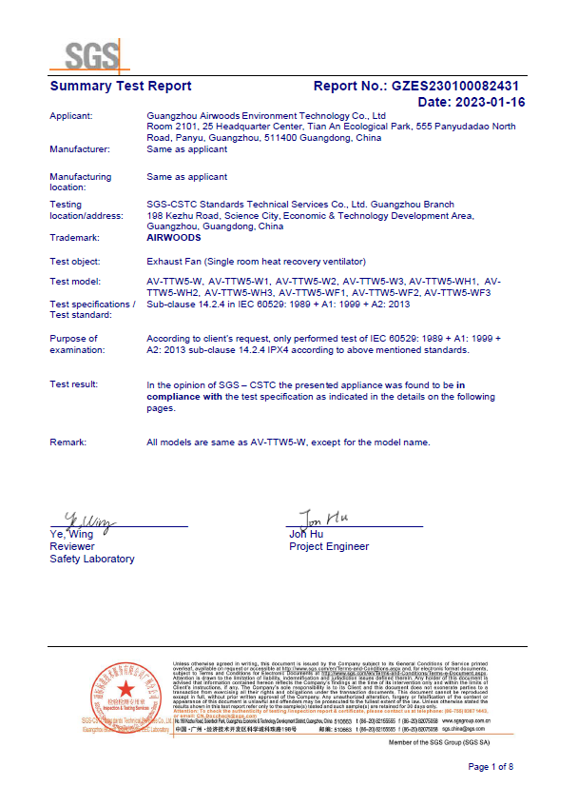
Certification
Eco Pair Plus has all the safety certificates from SGS and CSA to export to anywhere of the world.
CSA Certificate
CE Certificate
CB Certificate
EPCS Certificate
IP X4 Test Report

Slide 16


THANKS FOR WATCHING
Let’s Discuss & Build a Sustainable Future Together

